Slide 1
Capstone Engagement
Assessment, Analysis, and Hardening of a Vulnerable System

Slide 2
Table of Contents
This document contains the following sections:
01
Network Topology
02
Red Team: Security Assessment
03
Blue Team: Log Analysis and Attack Characterization
Hardening: Proposed Alarms and Mitigation Strategies
04

Slide 3
Network Topology
3

Slide 4
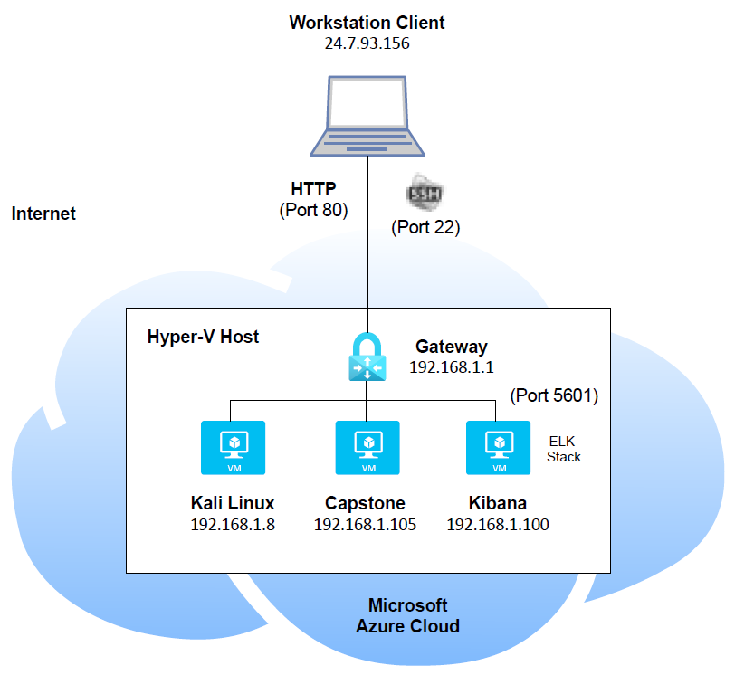
Network Topology
Network
Address Range: 192.168.1.0 /24
Netmask: 255.255.255.0
Gateway: 192.168.1.1
Machines
IPv4: 192.168.1.8
OS: Linux
Hostname: Kali Linux
IPv4: 192.168.1.105
OS: Linux
Hostname: Capstone
IPv4: 192.168.1.100:5601
OS: Linux
Hostname: Kibana

Slide 5

Red Team
Security Assessment
5

Slide 6
Recon: Describing the Target
Nmap identified the following hosts on the network:
Hostname | IP Address | Role on Network
Kali Linux | 192.168.1.8 | Attacker
Capstone | 192.168.1.105 | Victim
Kibana | 192.168.1.100:5601 | Data visualization dashboard

Slide 7
Vulnerability Assessment
The assessment uncovered the following critical vulnerabilities in the target:
Vulnerability | Description | Impact
Access to sensitive directories/files. | Access to sensitive directories/files such as the ‘secret_folder’ and its contents. | This vulnerability allows attackers to view sensitive documents to exploit the system or steal data.
Brute force attacks. | Brute force attacks allows retrieval of account/user passwords. | A brute force attack allows attackers access to accounts to gain access to a system.
File/shell script uploads. | Unauthorized ability to upload files and shell scripts. | This vulnerability allows attackers to execute these malicious files to target the system.
Reverse shell session. | Ability to execute a reverse shell to start a meterpreter session. | Access to a meterpreter session allows hackers to maneuver within a system and exploit it.

Slide 8
Exploitation: Access to sensitive directories/files
01
02
03
Tools & Processes
Tools used to gain access to the ‘secret_folder:
- nmap
- Web browser
- hydra
Achievements
Able to access the ‘secret_folder’ directory to view the contents file, ‘connect_to_corp_server’, which gave instructions on how to connect to the victim’s machine.
- # nmap 192.168.1.8/24
- Navigate to 192.168.1.105/company_folders/secret_folder
# hydra –l ashton –P /usr/share/wordlists/rockyou.txt –s 80 –f -v 192.168.1.105 http-get /company_folders/secret_folder

Slide 9
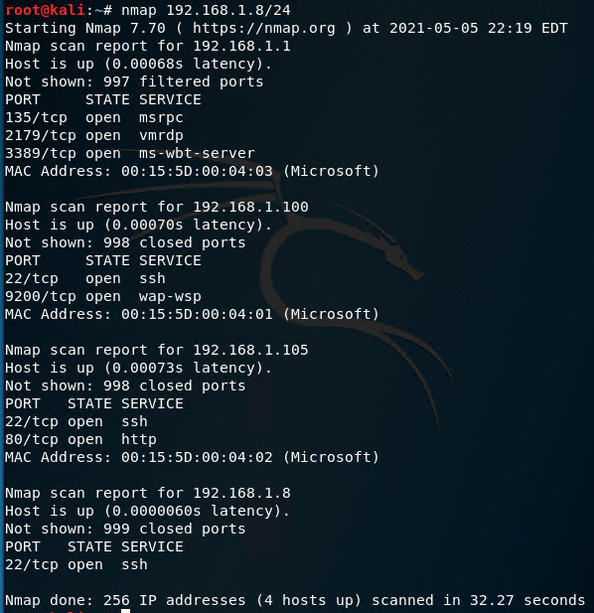
Exploitation: Access to sensitive directories/files (con’t) Perform a port scan to retrieve host and service information:

Slide 10
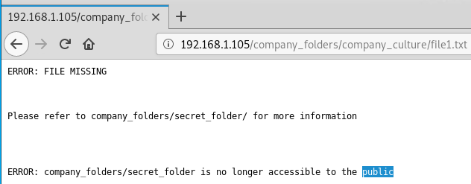
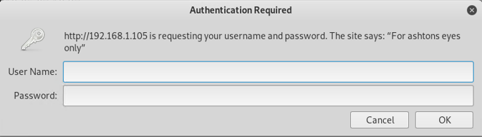
Exploitation: Access to sensitive directories/files (con’t) When navigating to 192.168.1.105, we are able to view files that indicate there is a ‘secret_folder’ directory: To access the ‘secret_folder’, we need to find the password for ‘ashton’ (username was noted during authentication prompt):
)

Slide 11
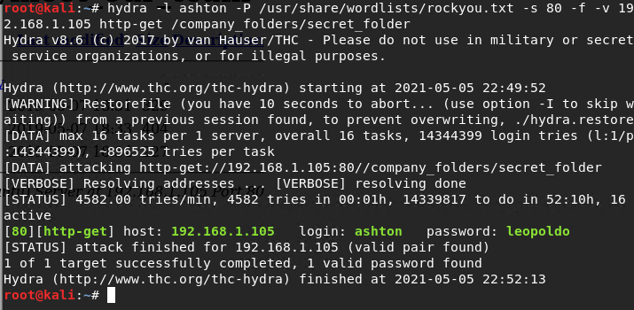
Exploitation: Access to sensitive directories/files (con’t) Brute force the password for the hidden directory using the hydra command: - Retrieved login credentials: ashton / leopolo

Slide 12
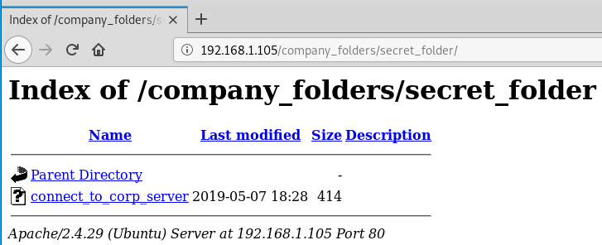
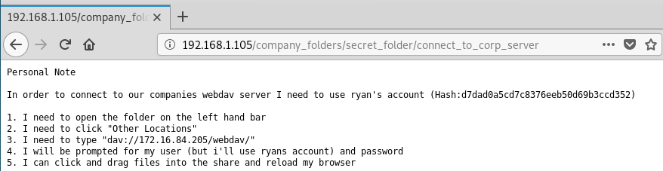
Exploitation: Access to sensitive directories/files (con’t) Successful access to the contents of the ‘secret_folder’ directory:

Slide 13
Exploitation: Brute force attacks
01
02
03
Tools & Processes
Tools used to brute force account passwords:
- hydra
- Crack Station website
Achievements
Able to gain access to the ‘secret_folder’ and to connect to the victim’s machine after cracking the passwords.
- # hydra –l ashton –P /usr/share/wordlists/rockyou.txt –s 80 –f -v 192.168.1.105 http-get /company_folders/secret_folder
- Crack Station website
Note: Hash password was
indicated in the
‘connect_to_corp_server’
file.

Slide 14
Exploitation: Brute force attacks (con’t) Brute force the password for the hidden directory (secret_folder) using the hydra command: Break the hash password for the user ‘ryan’ using Crack Station:

Slide 15
Exploitation: File/shell script uploads
01
02
03
Tools & Processes
Tools used to upload a PHP reverse shell payload script:
- File Manager
- msvenom
Achievements
Ability to upload a PHP script to the WebDav server.
- From file manager,
connect to WebDav server: dav://192.168.1.105/webdav
Create and upload a PHP
reverse shell payload
script called ‘shell.php’.

Slide 16
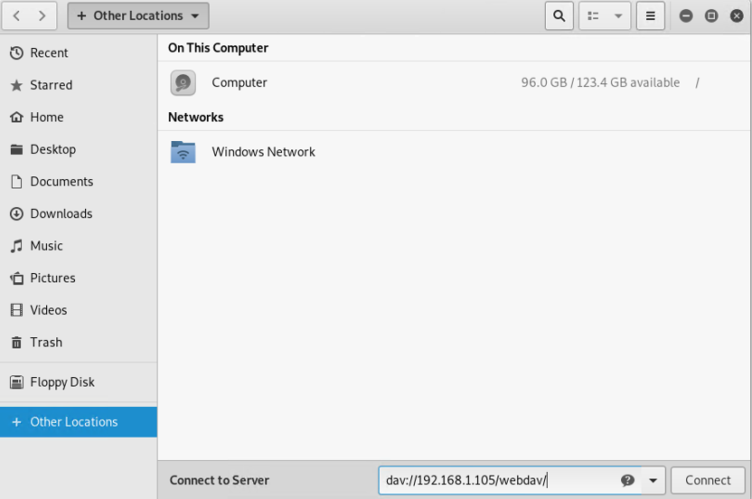
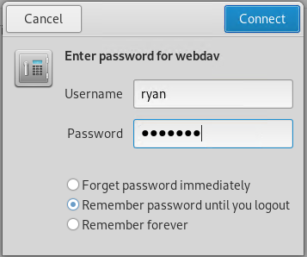
Exploitation: File/shell script uploads (con’t) Connect to the WebDav server using the username ‘ryan’ and hash password recently cracked:

Slide 17
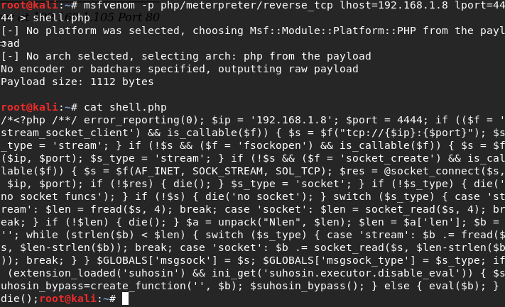
Exploitation: File/shell script uploads (con’t) Create and upload a PHP reverse shell payload script: - Using default port 4444.

Slide 18
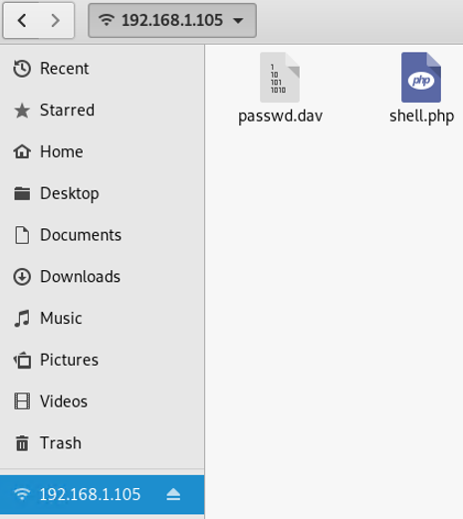
Exploitation: File/shell script uploads (con’t) Create and upload a PHP reverse shell payload script (con’t):
- Manually copied the ‘shell.php’ file from the Kali Linux machine to the WebDav server.

Slide 19
Exploitation: Reverse shell session
01
02
03
Tools & Processes
Tools used to execute a reverse shell session:
- msfconsole
- Web browser
Achievements
Ability to execute a reverse shell to start a meterpreter session.
# msfconsole
Navigate to the WebDav website:
192.168.1.105/webdav

Slide 20
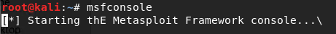
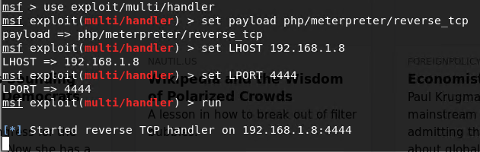
Exploitation: Reverse shell session (con’t) From Kali Linux, open up a Metasploit console to create a listener:

Slide 21
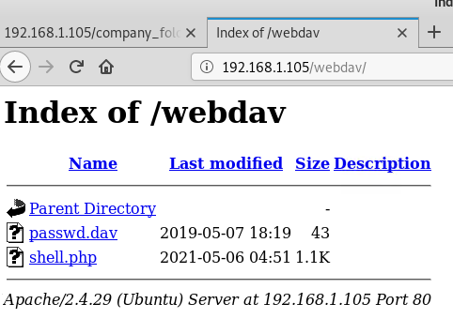
Exploitation: Reverse shell session (con’t) Navigate to the WebDav website to execute the reverse shell payload script ‘shell.php’: - Click on the ‘shell.php’ to open up a meterpreter session.

Slide 22
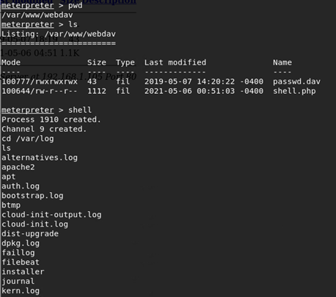
Exploitation: Reverse shell session (con’t) From the meterpreter session, we are able to maneuver within the system:
We can list the contents of a directory or even open up a shell session.

Slide 23
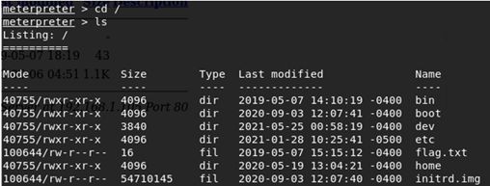
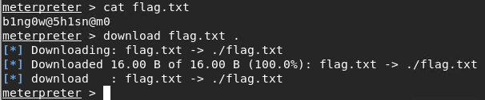
Exploitation: Reverse shell session (con’t) From the meterpreter session, we are able to maneuver within the system (con’t): We also have the ability to download a file.

Slide 24
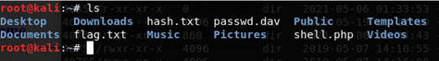
Exploitation: Reverse shell session (con’t) From the meterpreter session, we are able to maneuver within the system (con’t): We can see that we have successfully downloaded this ‘flag.txt’ file into our Kali machine:

Slide 25

Blue Team
Log Analysis and Attack Characterization
25

Slide 26
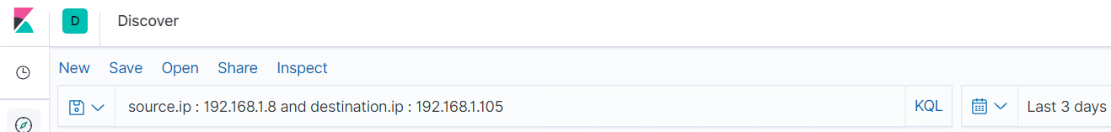
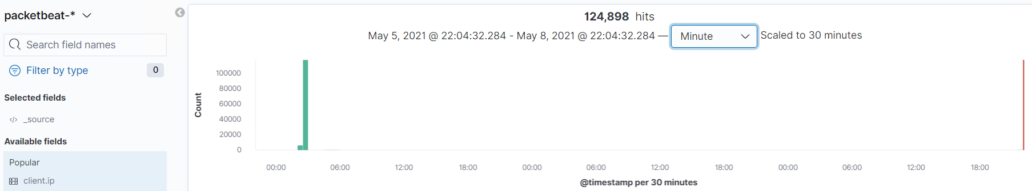
Analysis: Identifying the Port Scan The port scan occurred between May 5, 2021 through May 8, 2021 with 124,898 hits.

Slide 27
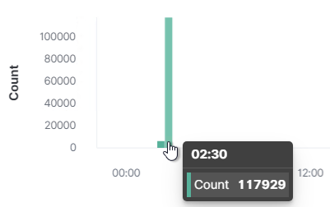
Analysis: Identifying the Port Scan (con’t) The interaction between the Kali machine and the Capstone machines occurred on May 6, 2021 between 02:00 – 02:30.

Slide 28
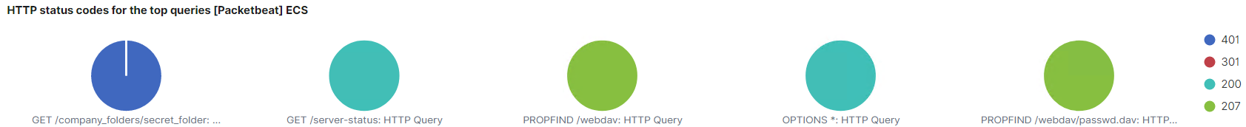
Analysis: Identifying the Port Scan (con’t) The ‘HTTP status codes for the top queries’ report shows the responses we received back from the Capstone’s machine. - The top responses were 401, 301, 200 and 207.

Slide 29
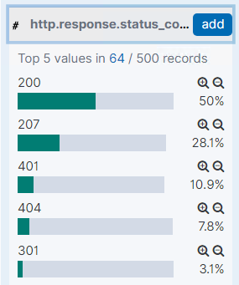
Analysis: Identifying the Port Scan (con’t) From the ‘Discover’ page for the traffic between the Kali and Capstone machines, if we click on the ‘Additional fields’, we see the ‘http.response_status_code’ percentage and count.

Slide 30
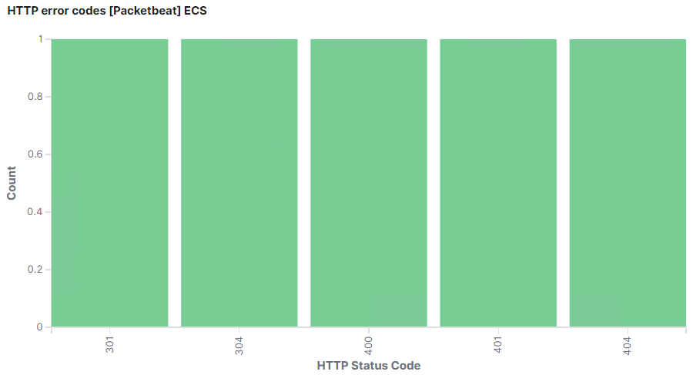
Analysis: Identifying the Port Scan (con’t) The ‘HTTP error codes’ report shows the error codes we received back from the Capstone machine.

Slide 31
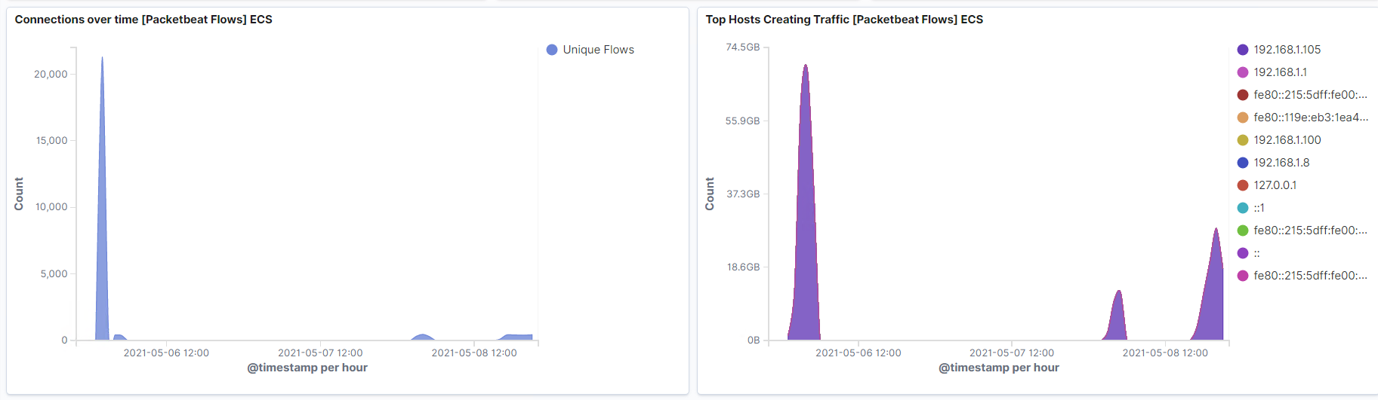
Analysis: Identifying the Port Scan (con’t) From our reports, ‘Connection over time’ and ‘Top Hosts Creating Traffic’, we can see a lot of high traffic coming from the Capstone’s machine @ 192.168.1.105. - There was a sudden spike over time on May 6, 2021.

Slide 32
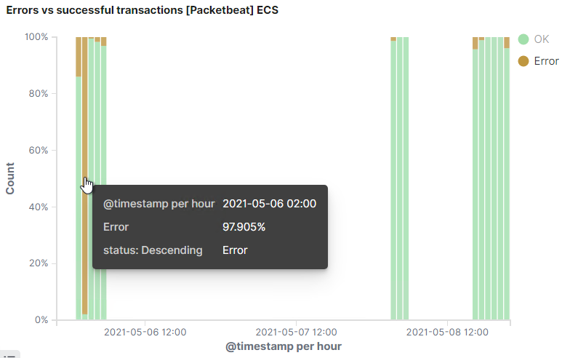
Analysis: Identifying the Port Scan (con’t) The ‘Errors vs successful transactions’ report also indicates we had errors.

Slide 33
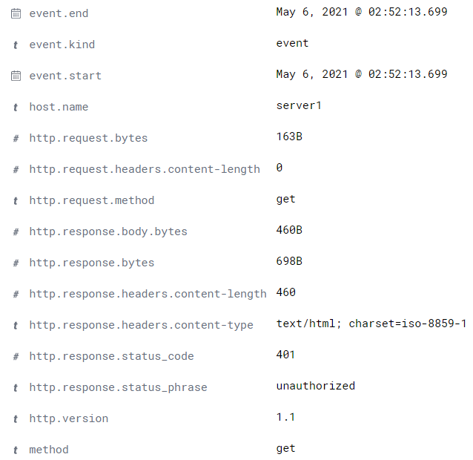
Analysis: Identifying the Port Scan (con’t) Example of log reported on May 6, 2021 @ 02:52:13:

Slide 34
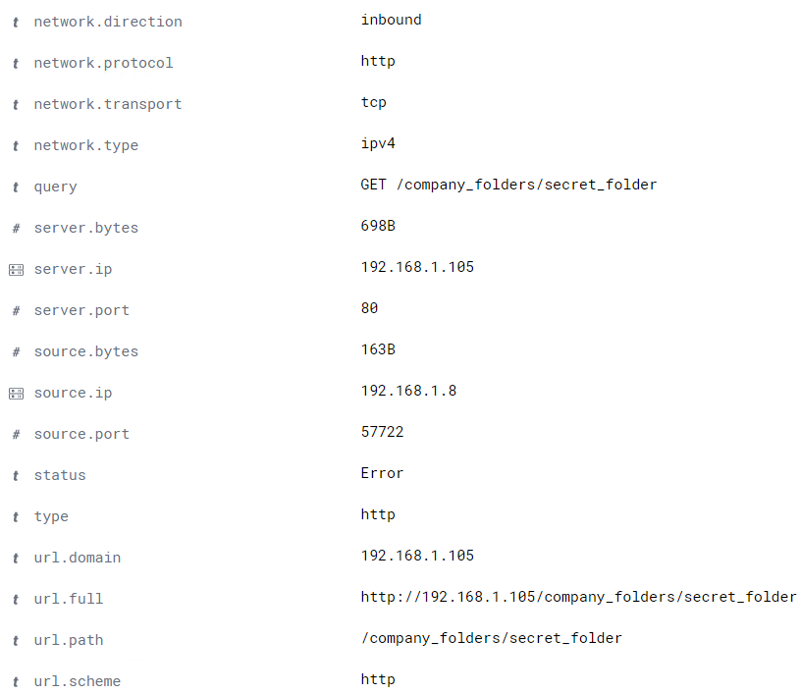
Analysis: Identifying the Port Scan (con’t) Example of log reported on May 6, 2021 @ 02:52:13: (con’t)

Slide 35
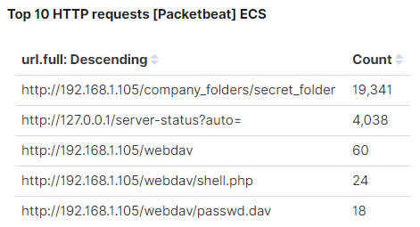
Analysis: Finding the Request for the Hidden Directory From the ‘Top 10 HTTP requests’, we can see that the ‘/company_folders/secret_folder’ directory was requested 19,341 times.

Slide 36
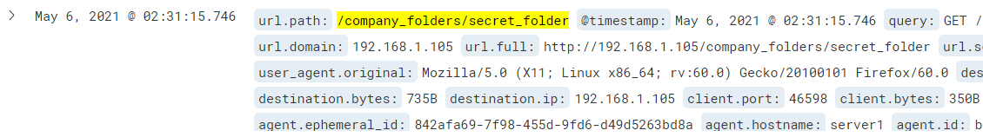
Analysis: Finding the Request for the Hidden Directory (con’t) The request for the ‘secret_folder’ directory started on May 6, 2021 @ 02:31.

Slide 37
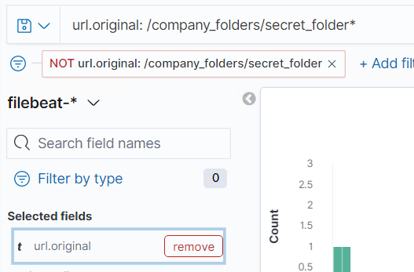
Analysis: Finding the Request for the Hidden Directory (con’t) The ‘secret_folder’ directory contains a file called ‘connect_to_server’. By searching for the ‘secret_folder’ directory, we can verify that this is the only file in this directory.

Slide 38
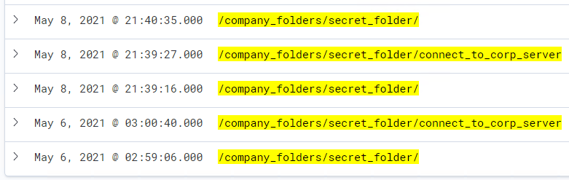
Analysis: Finding the Request for the Hidden Directory (con’t) Search results verifies that only one file, ‘connect_to_corp_server’, is located in the ‘secret_folder’ directory.

Slide 39
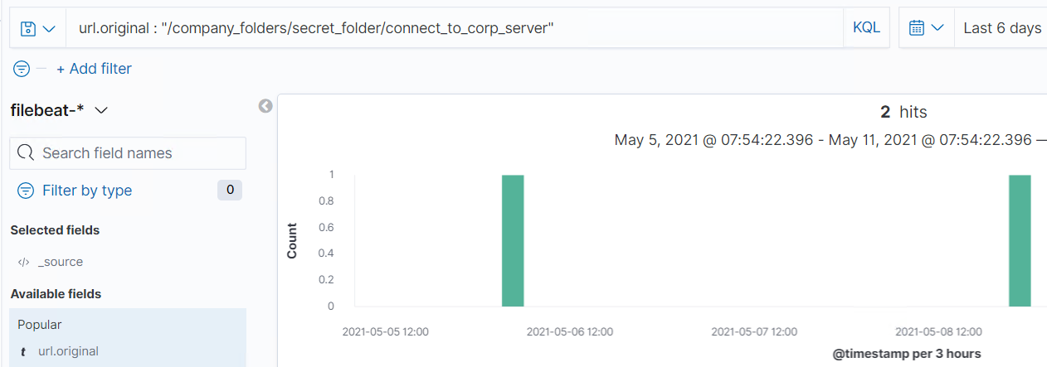
Analysis: Uncovering the Brute Force Attack Again, from the ‘Top 10 HTTP requests’, we know that the ‘/company_folders/secret_folder’ directory was requested 19,341 times. By searching for the ‘connect_to_corp_server’ file in the ‘/company_folders/secret_folder’ directory, the search result shows the file was successfully accessed 2 times.

Slide 40
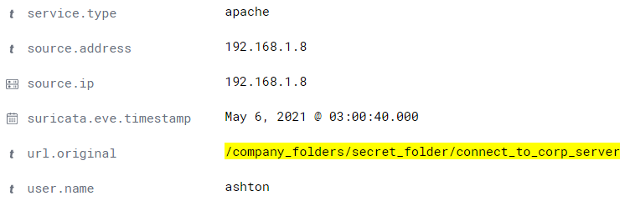
Analysis: Uncovering the Brute Force Attack (con’t) The log from May 6, 2021 indicates that the ‘connect_to_corp_server’ file was accessed using the username ‘ashton’.

Slide 41
Analysis: Finding the WebDAV Connection From the ‘Top 10 HTTP requests’, we can see that the ‘http://192.168.1.105/webdav’ directory was requested 60 times. - Within this directory, we were able to view and access two files ‘shell.php’ and ‘passwd.dav’.

Slide 42
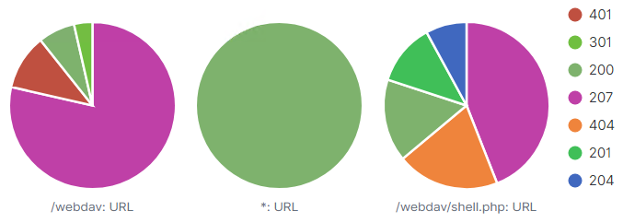
Analysis: Finding the WebDAV Connection (con’t) From the ‘Top URLs by response code’, we can see the response codes returned.

Slide 43
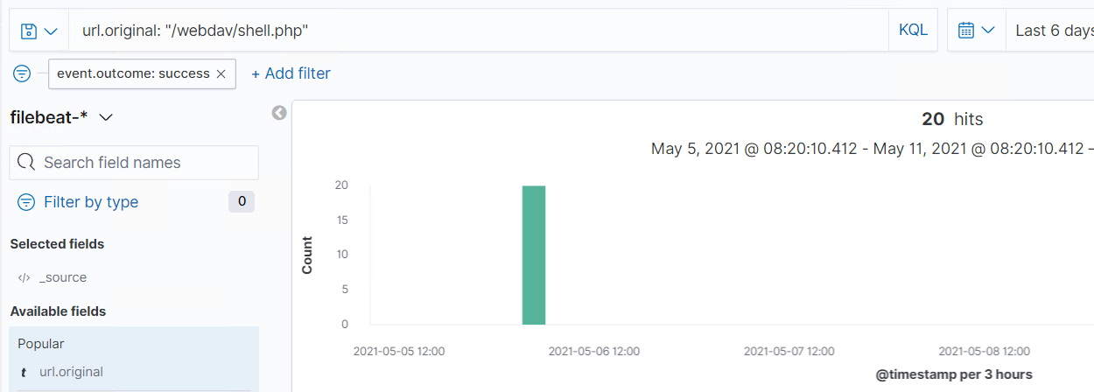
Analysis: Finding the WebDAV Connection (con’t) By searching for the /webdav/shell.php’ file, the search result shows the file was successfully accessed 20 times.

Slide 44
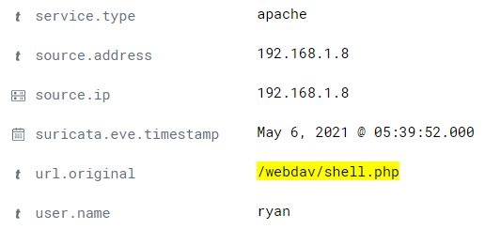
Analysis: Finding the WebDAV Connection (con’t) The log from May 6, 2021 indicates that the ‘/webdav/shell.php’ file was accessed using the username ‘ryan’.

Slide 45
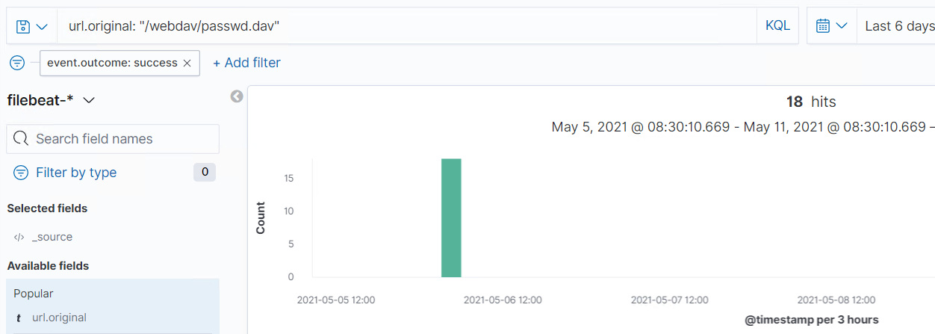
Analysis: Finding the WebDAV Connection (con’t) By searching for the /webdav/passwd.dav’ file, the search result shows the file was successfully accessed 18 times.

Slide 46
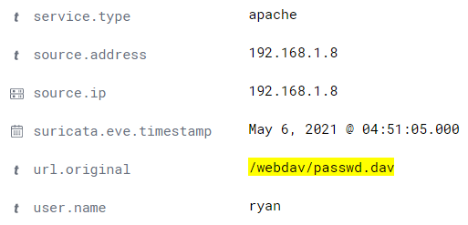
Analysis: Finding the WebDAV Connection (con’t) The log from May 6, 2021 indicates that the ‘/webdav/passwd.dav’ file was accessed using the username ‘ryan’.

Slide 47
Blue Team
Proposed Alarms and Mitigation Strategies
47

Slide 48
Mitigation: Blocking the Port Scan
Set an alarm to detect a port scan from a specific IP address (ie 192.168.1.8) with a threshold of maybe 25 scans per minute or 150 ping requests per minute.
Disable ports that don't need to be accessed from outside the organization.
Install a firewall and an intrusion detection system.
Perform routine port scans on your network.

Slide 49
Mitigation: Finding the Request for the Hidden Directory
Set an alarm to detect unauthorized access to directories/files (ie. ‘secret_folder’) if an IP address is not on the “allow” list.
Set an alarm if a specific directory/file (ie. secret_folder”) is accessed other than a specific user such as the system administrator.
Restrict access to specific files by using an “allow” list.
Disable the directory listing on the Apache web server.
Encrypt sensitive files.

Slide 50
Mitigation: Preventing Brute Force Attacks
Set an alarm to detect brute force attacks if there is excessive warnings of unsuccessful login attempts with a threshold of maybe 50,000 attempts per second.
Set an alarm if a specific IP address (ie 192.168.1.8) is attempting to login with a threshold of maybe again 50,000 attempts per second.
Another alarm is if there is excessive login attempts for the system administrator account.
Passwords should be strong and complex.
Enable multi-factor authentication.
Restrict the number of login attempts.
Enable CAPTCHA (Completely Automated Public Turing test to tell Computers and Humans Apart), to determine whether a user's input is coming from a human or a machine/bot.
Require a user to answer one or two of their secret questions in addition to their username and password when there is a failed login attempt.

Slide 51
Mitigation: Detecting the WebDAV Connection
Set an alarm to detect connection to the WebDav server if the connection is not a user or IP address on the “allow” list.
Require login authentication by using SSH keys.
Install an intrusion detection system or intrusion prevention system.
Perform regular updates and patches.
Remove unnecessary features of the operating system and accounts that are expired or not used.
Disable services not used.

Slide 52
Mitigation: Identifying Reverse Shell Uploads
Set an alarm to detect file uploads if an IP address is not on the “allow” list.
Set an alarm if the WebDav directories that contain executable files are accessed other than a specific user such as the system administrator.
Restrict access to executable files by using an “allow” list.
Require authentication when files are uploaded by using SSH keys.
Restrict executable files from being accessed from the web.

